Slide 1
SYNCHROTRON RADIATION WITH PYTHON
ASTRO JEDI IN NAMIBIA

Slide 2
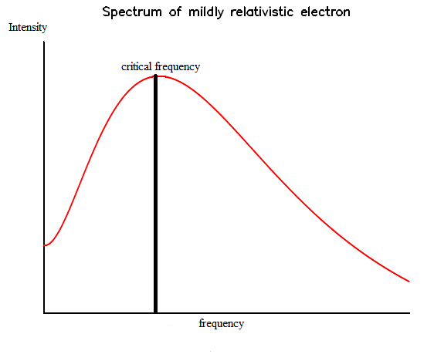
Expected synchrotron compton

Slide 3
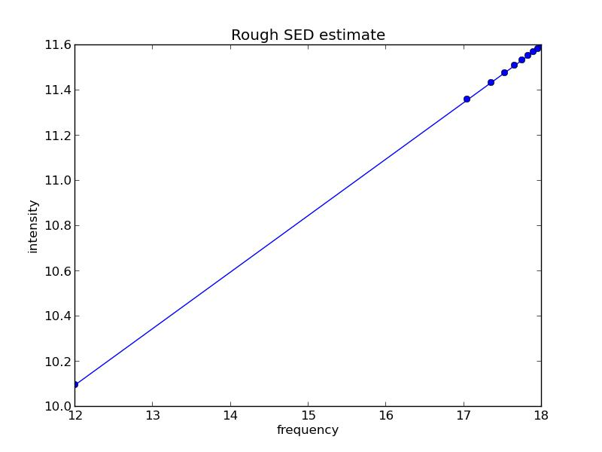
SED from an extremely rough code (electrons not treated)

Slide 4
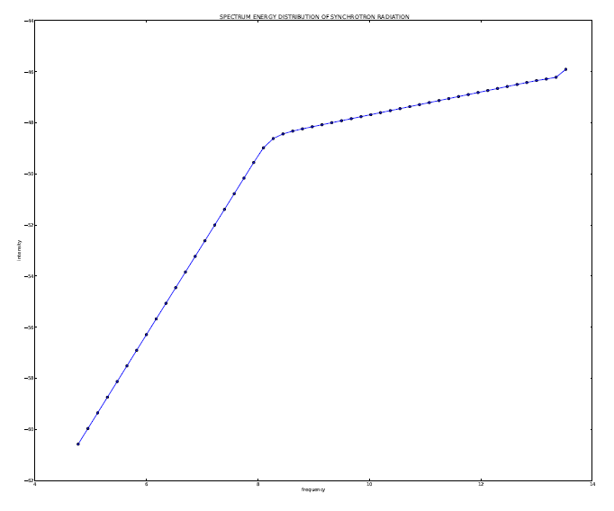
SED from a more rigorous synchrotron spectrum

Slide 5
Work to do
Change p, B, electron energies, etc. to study the parameter influence

